Slide 1


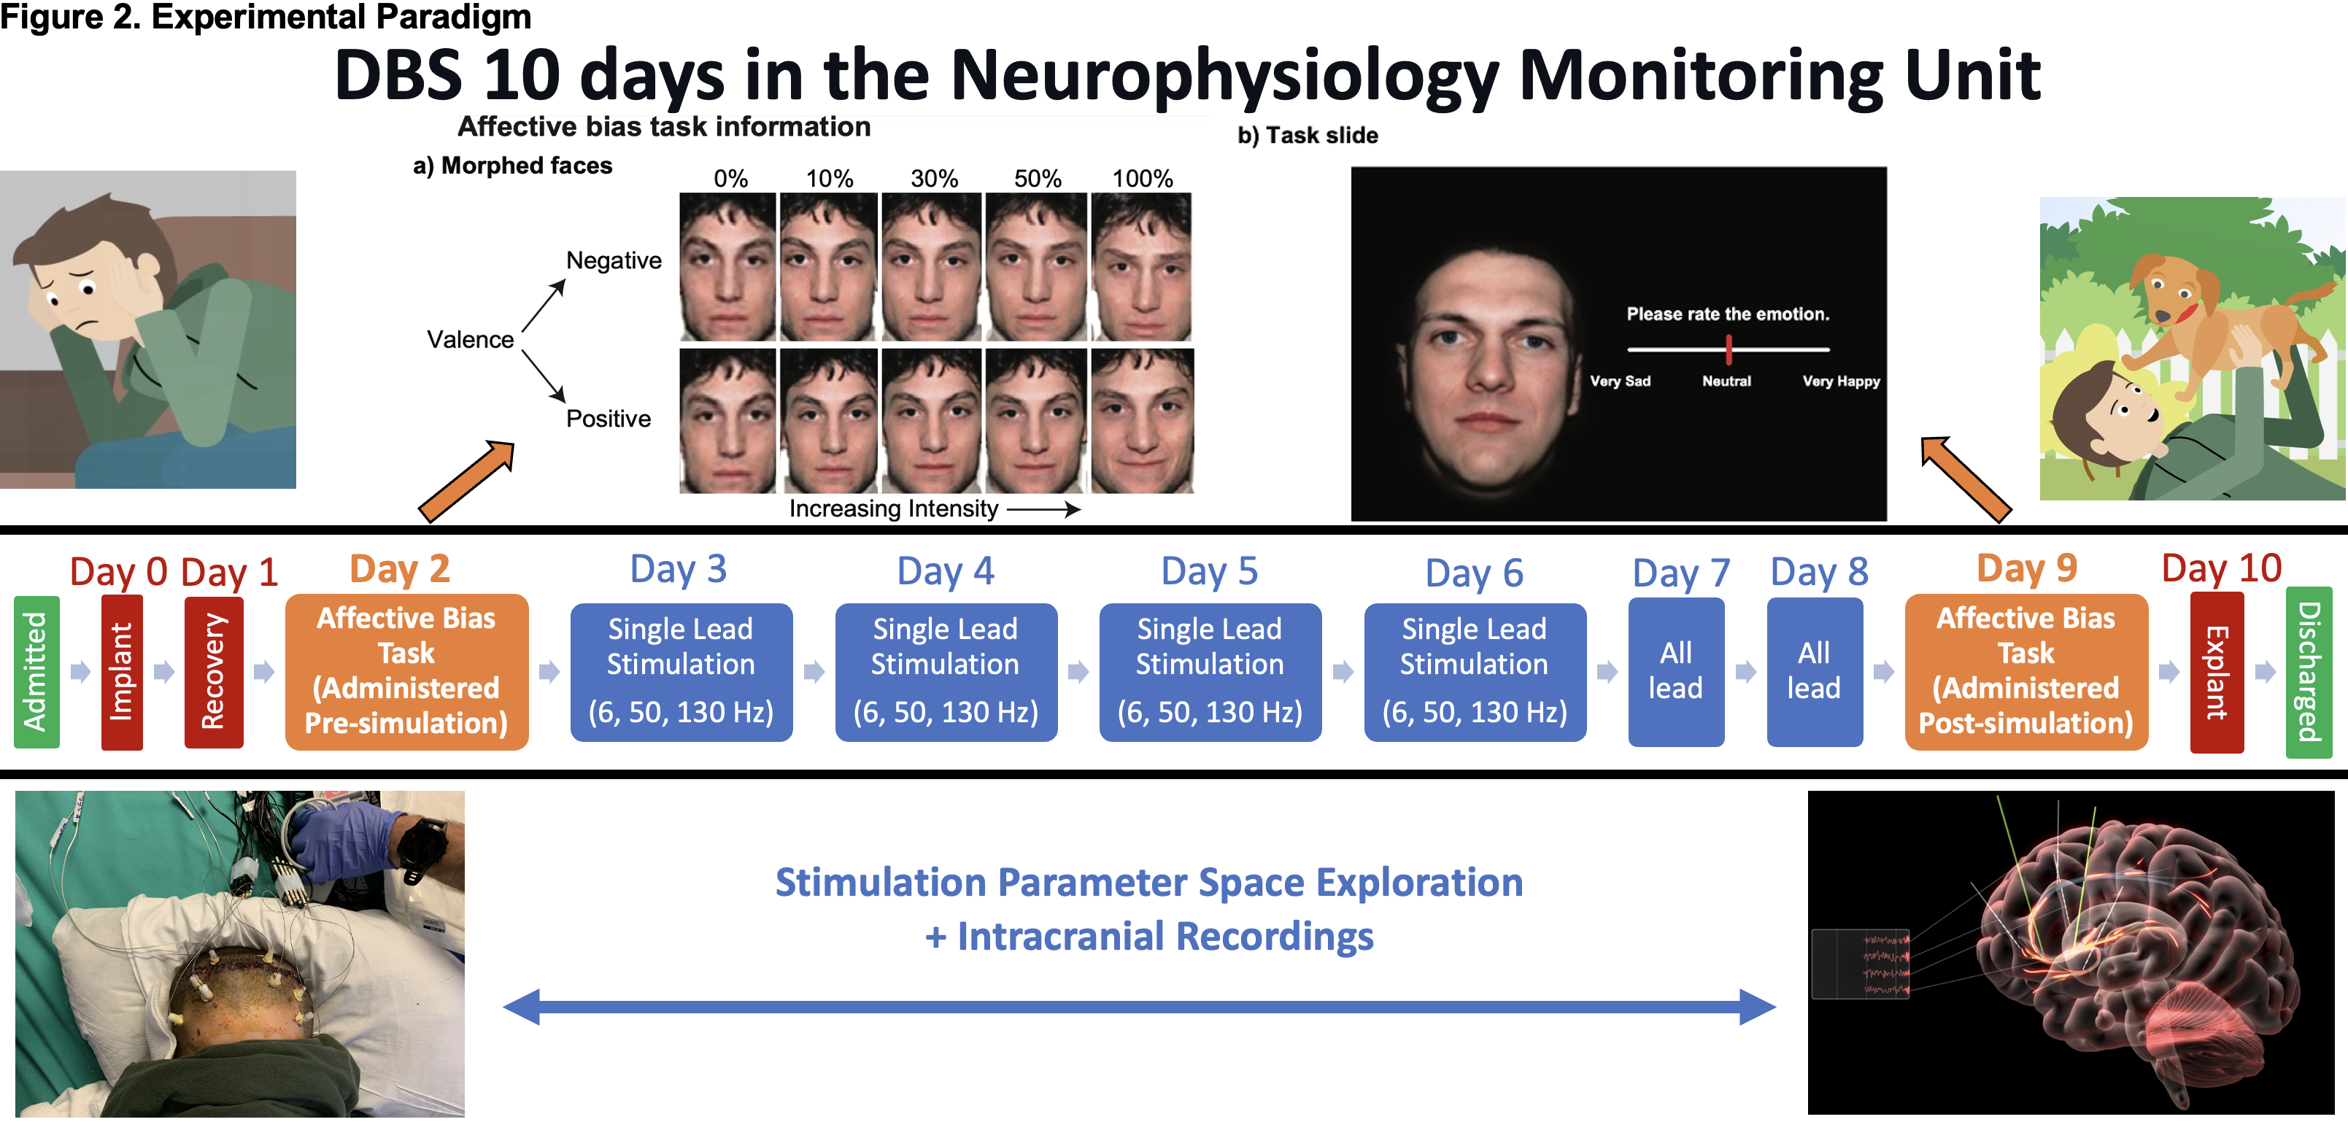
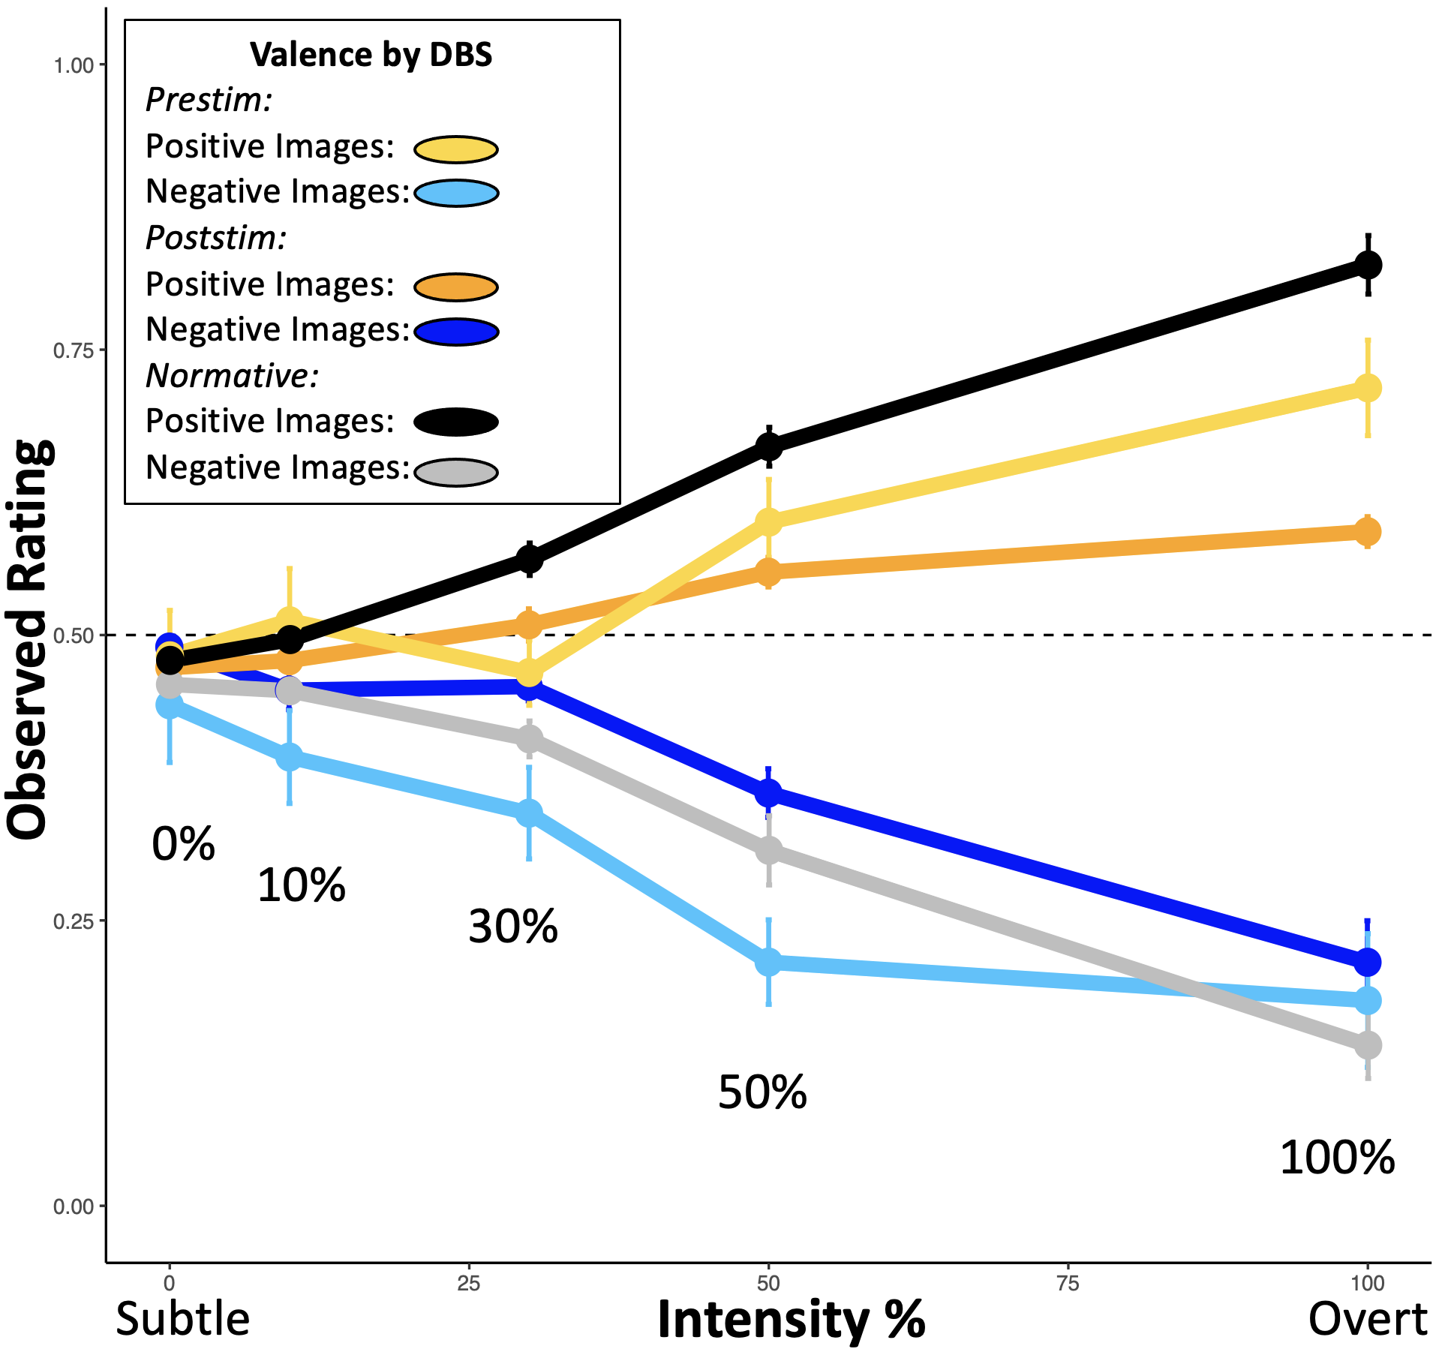
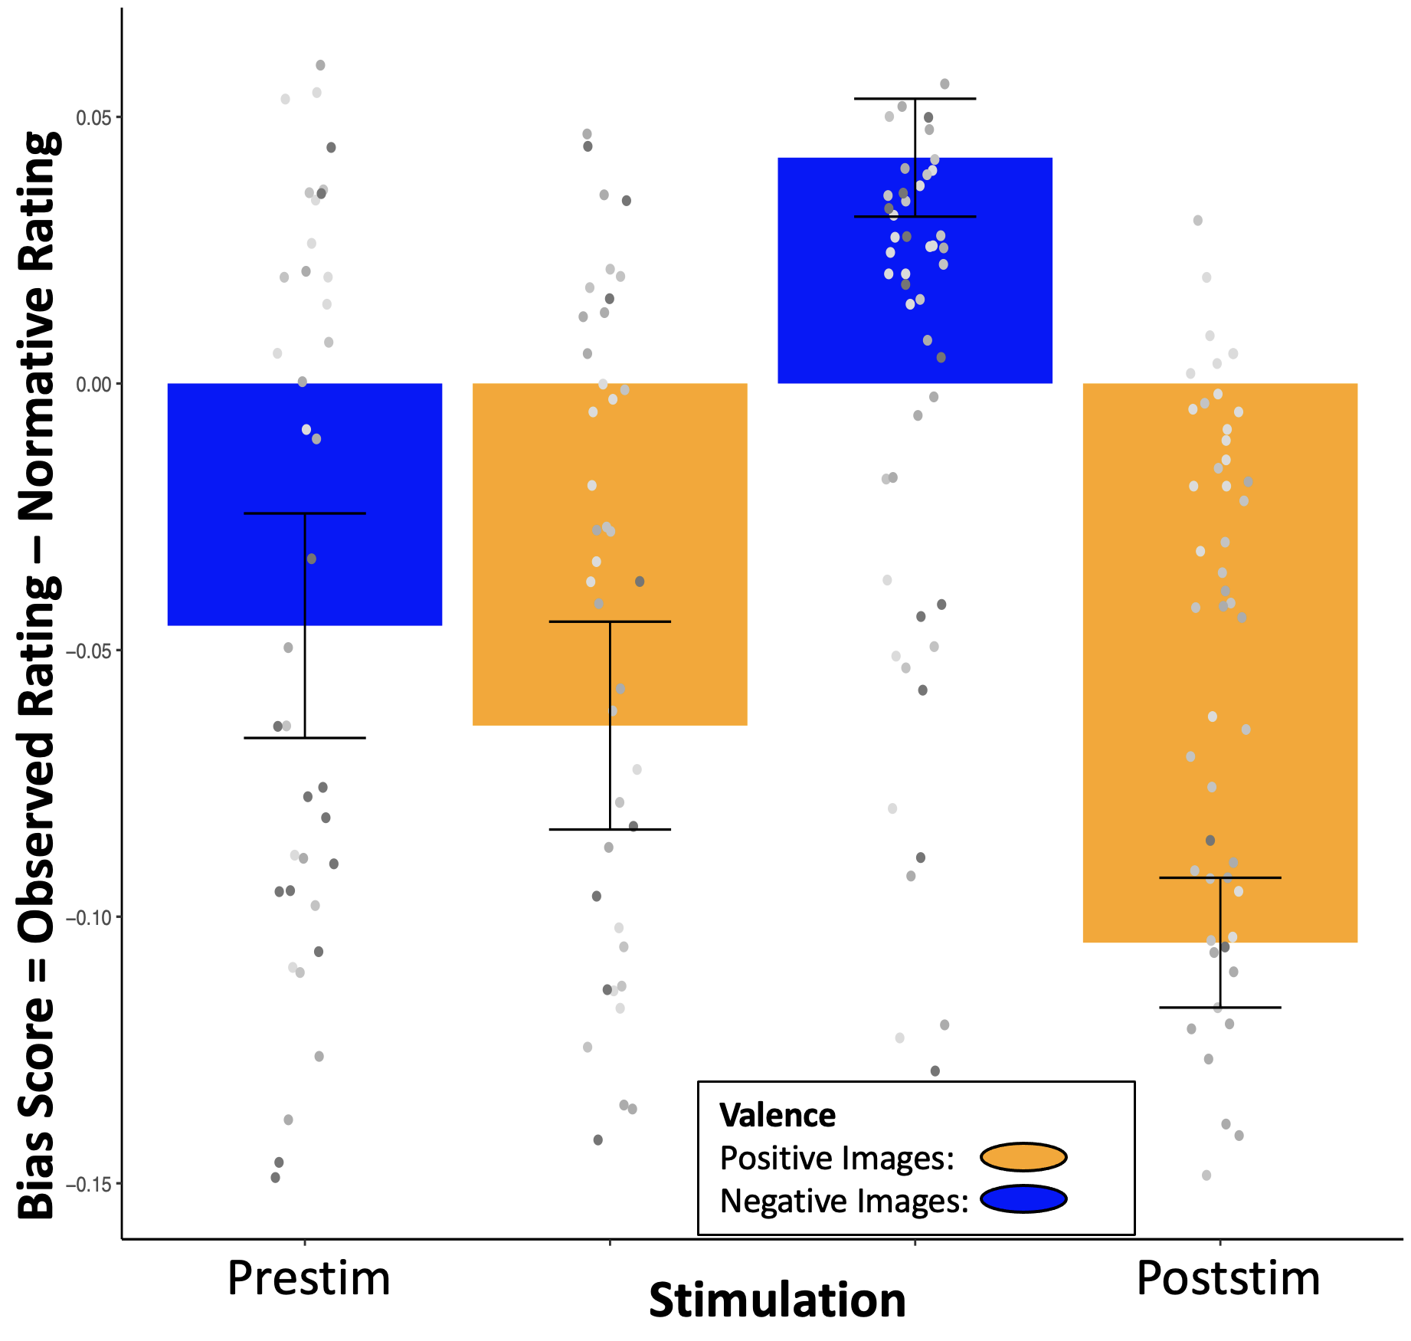
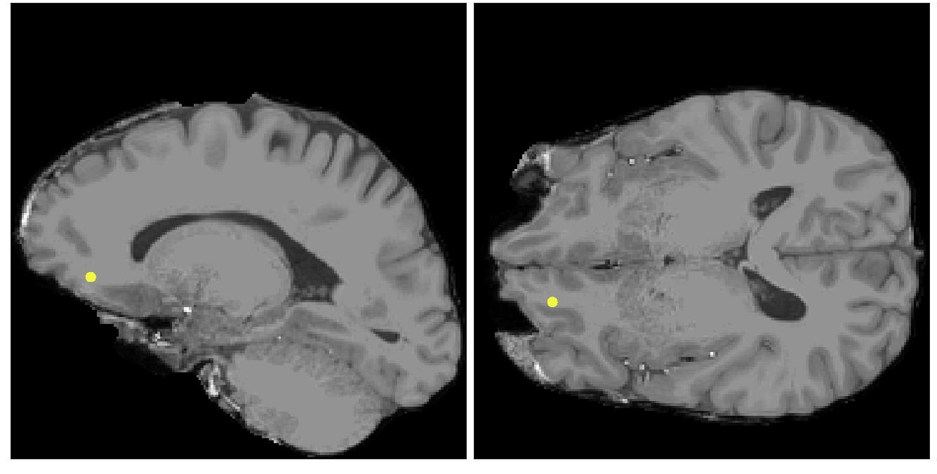
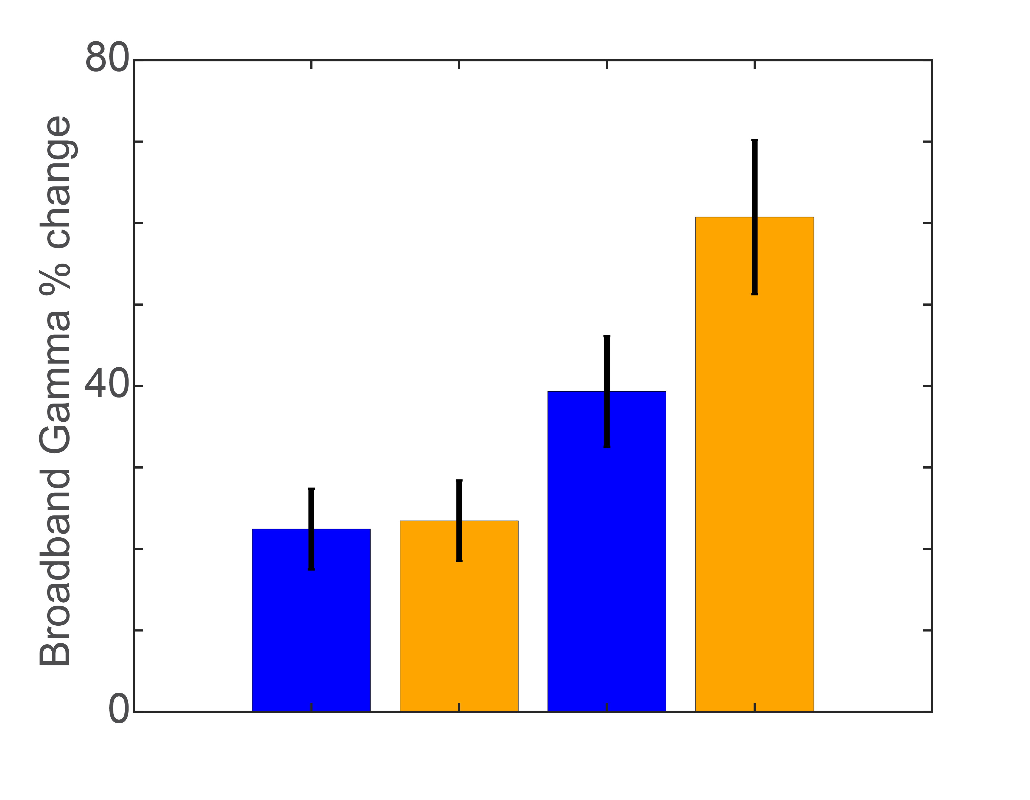
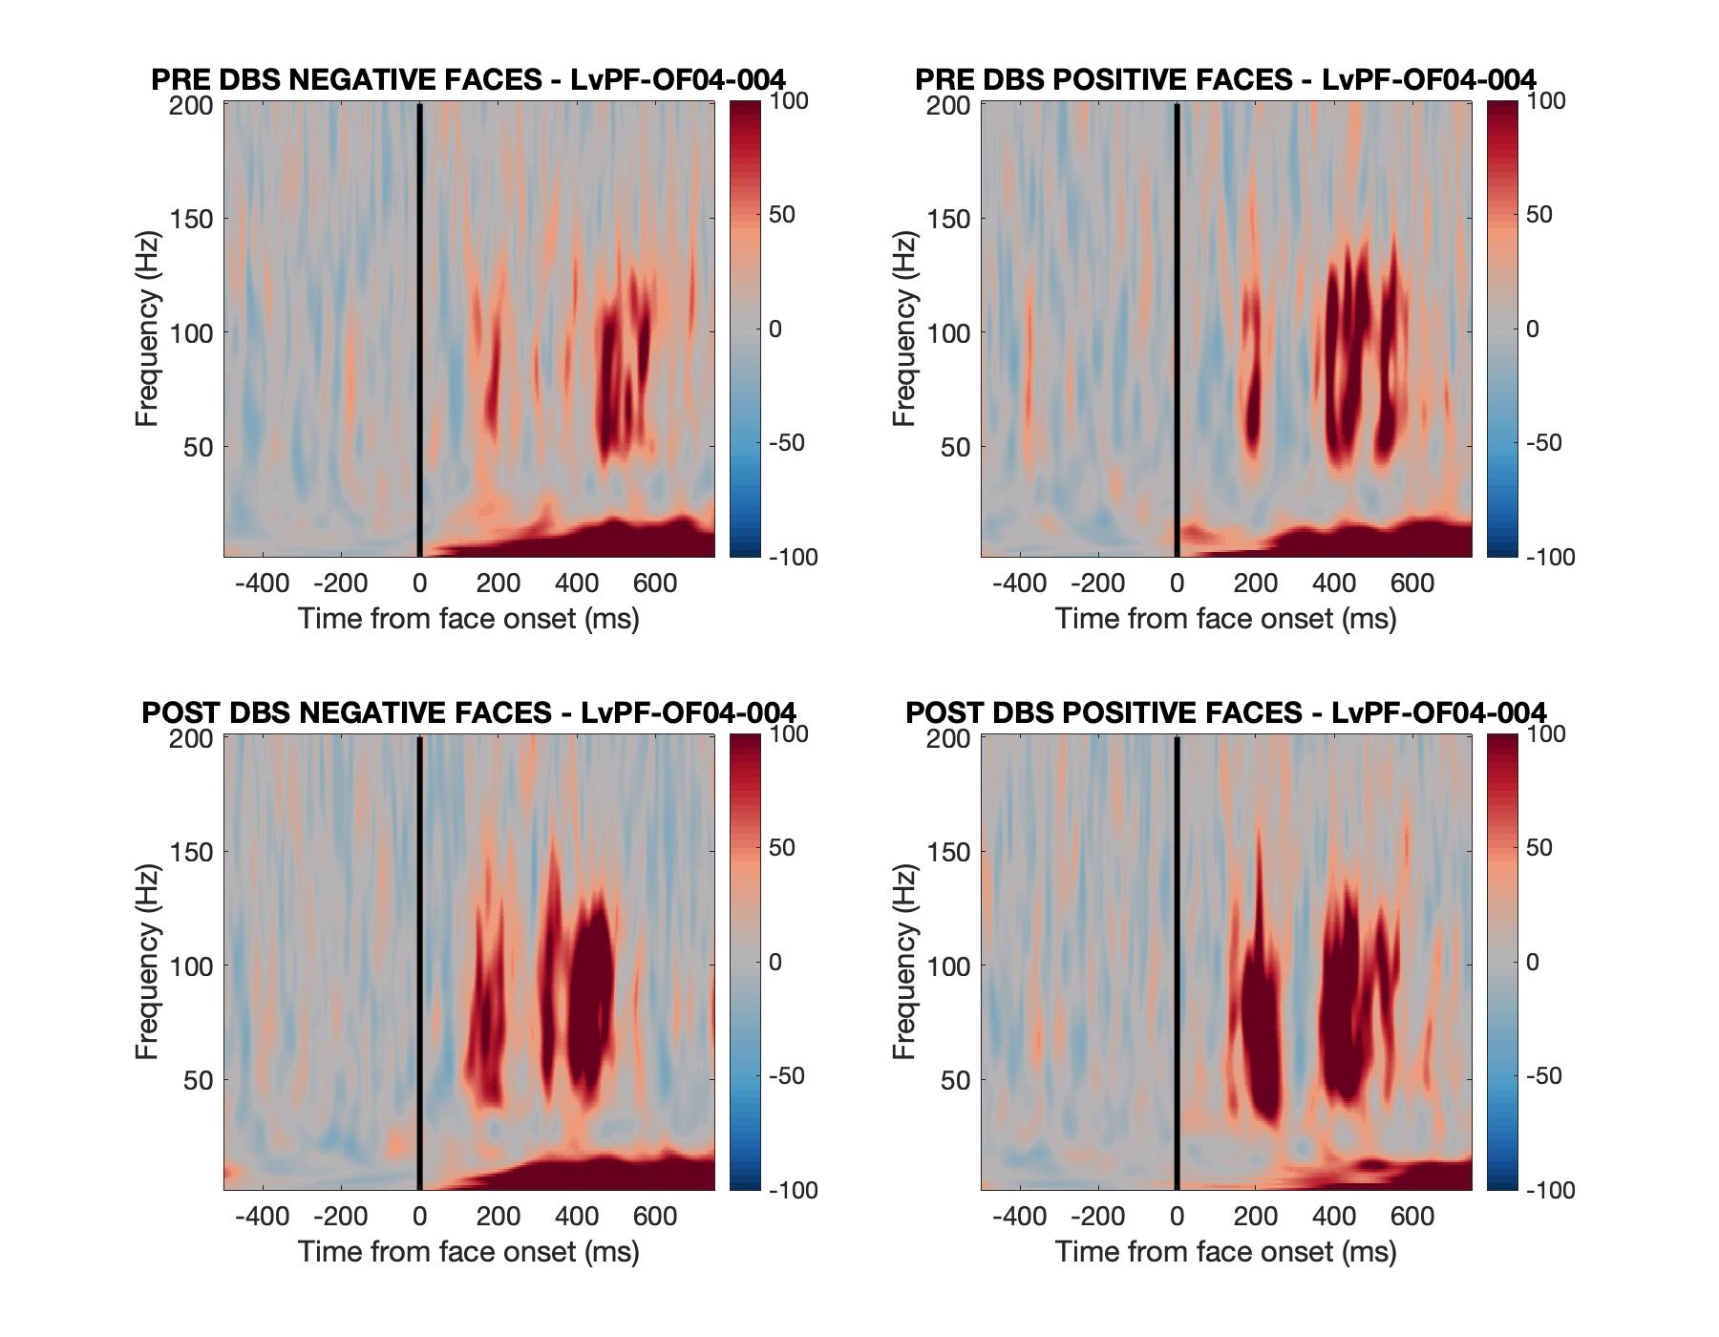
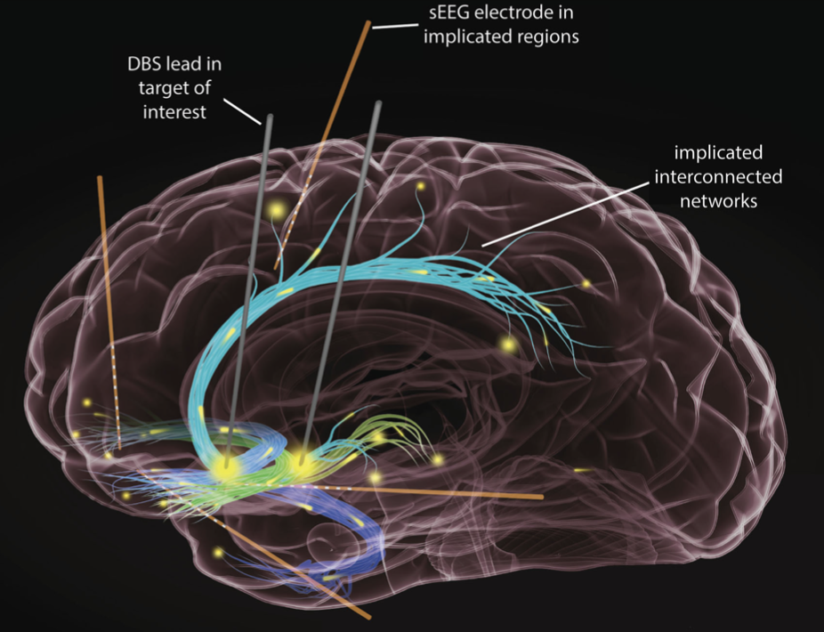
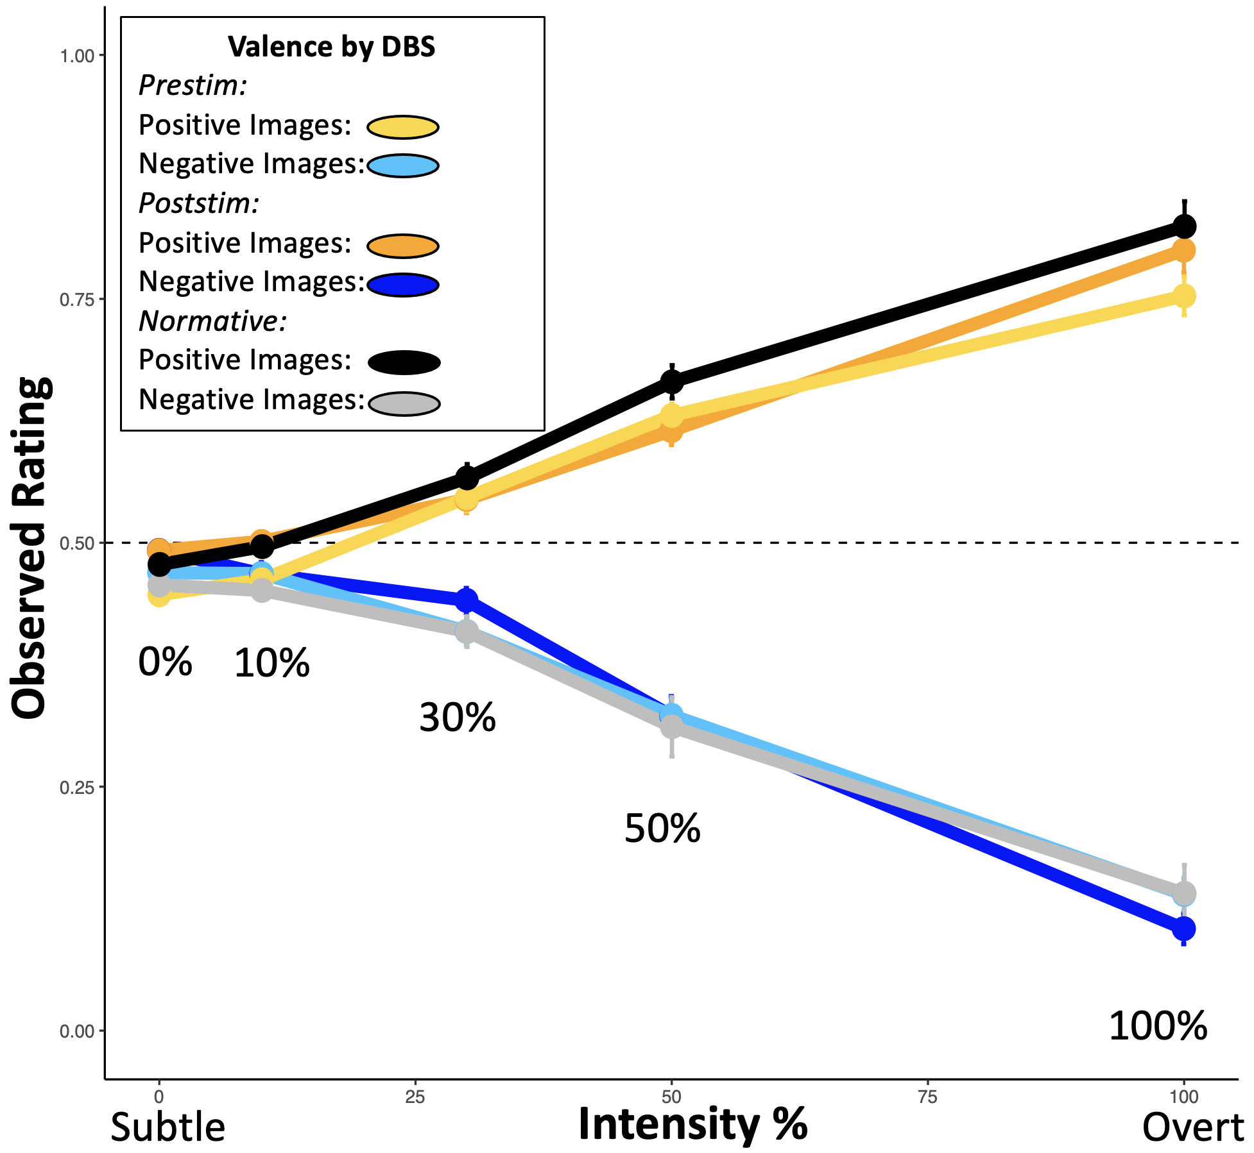
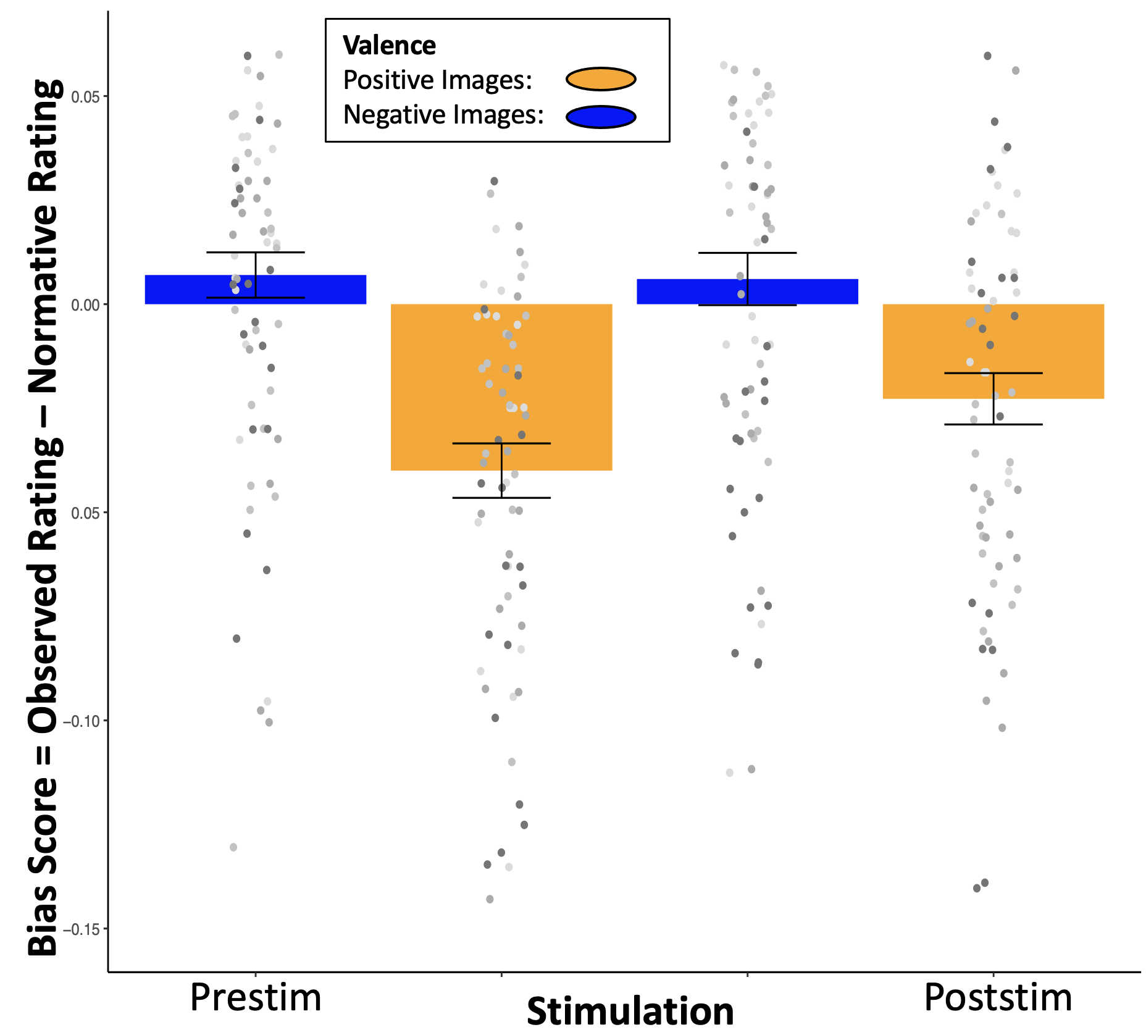
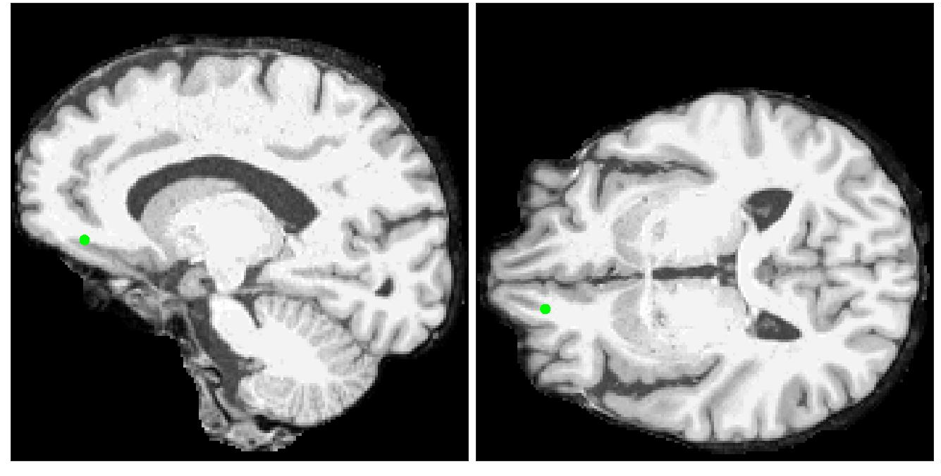
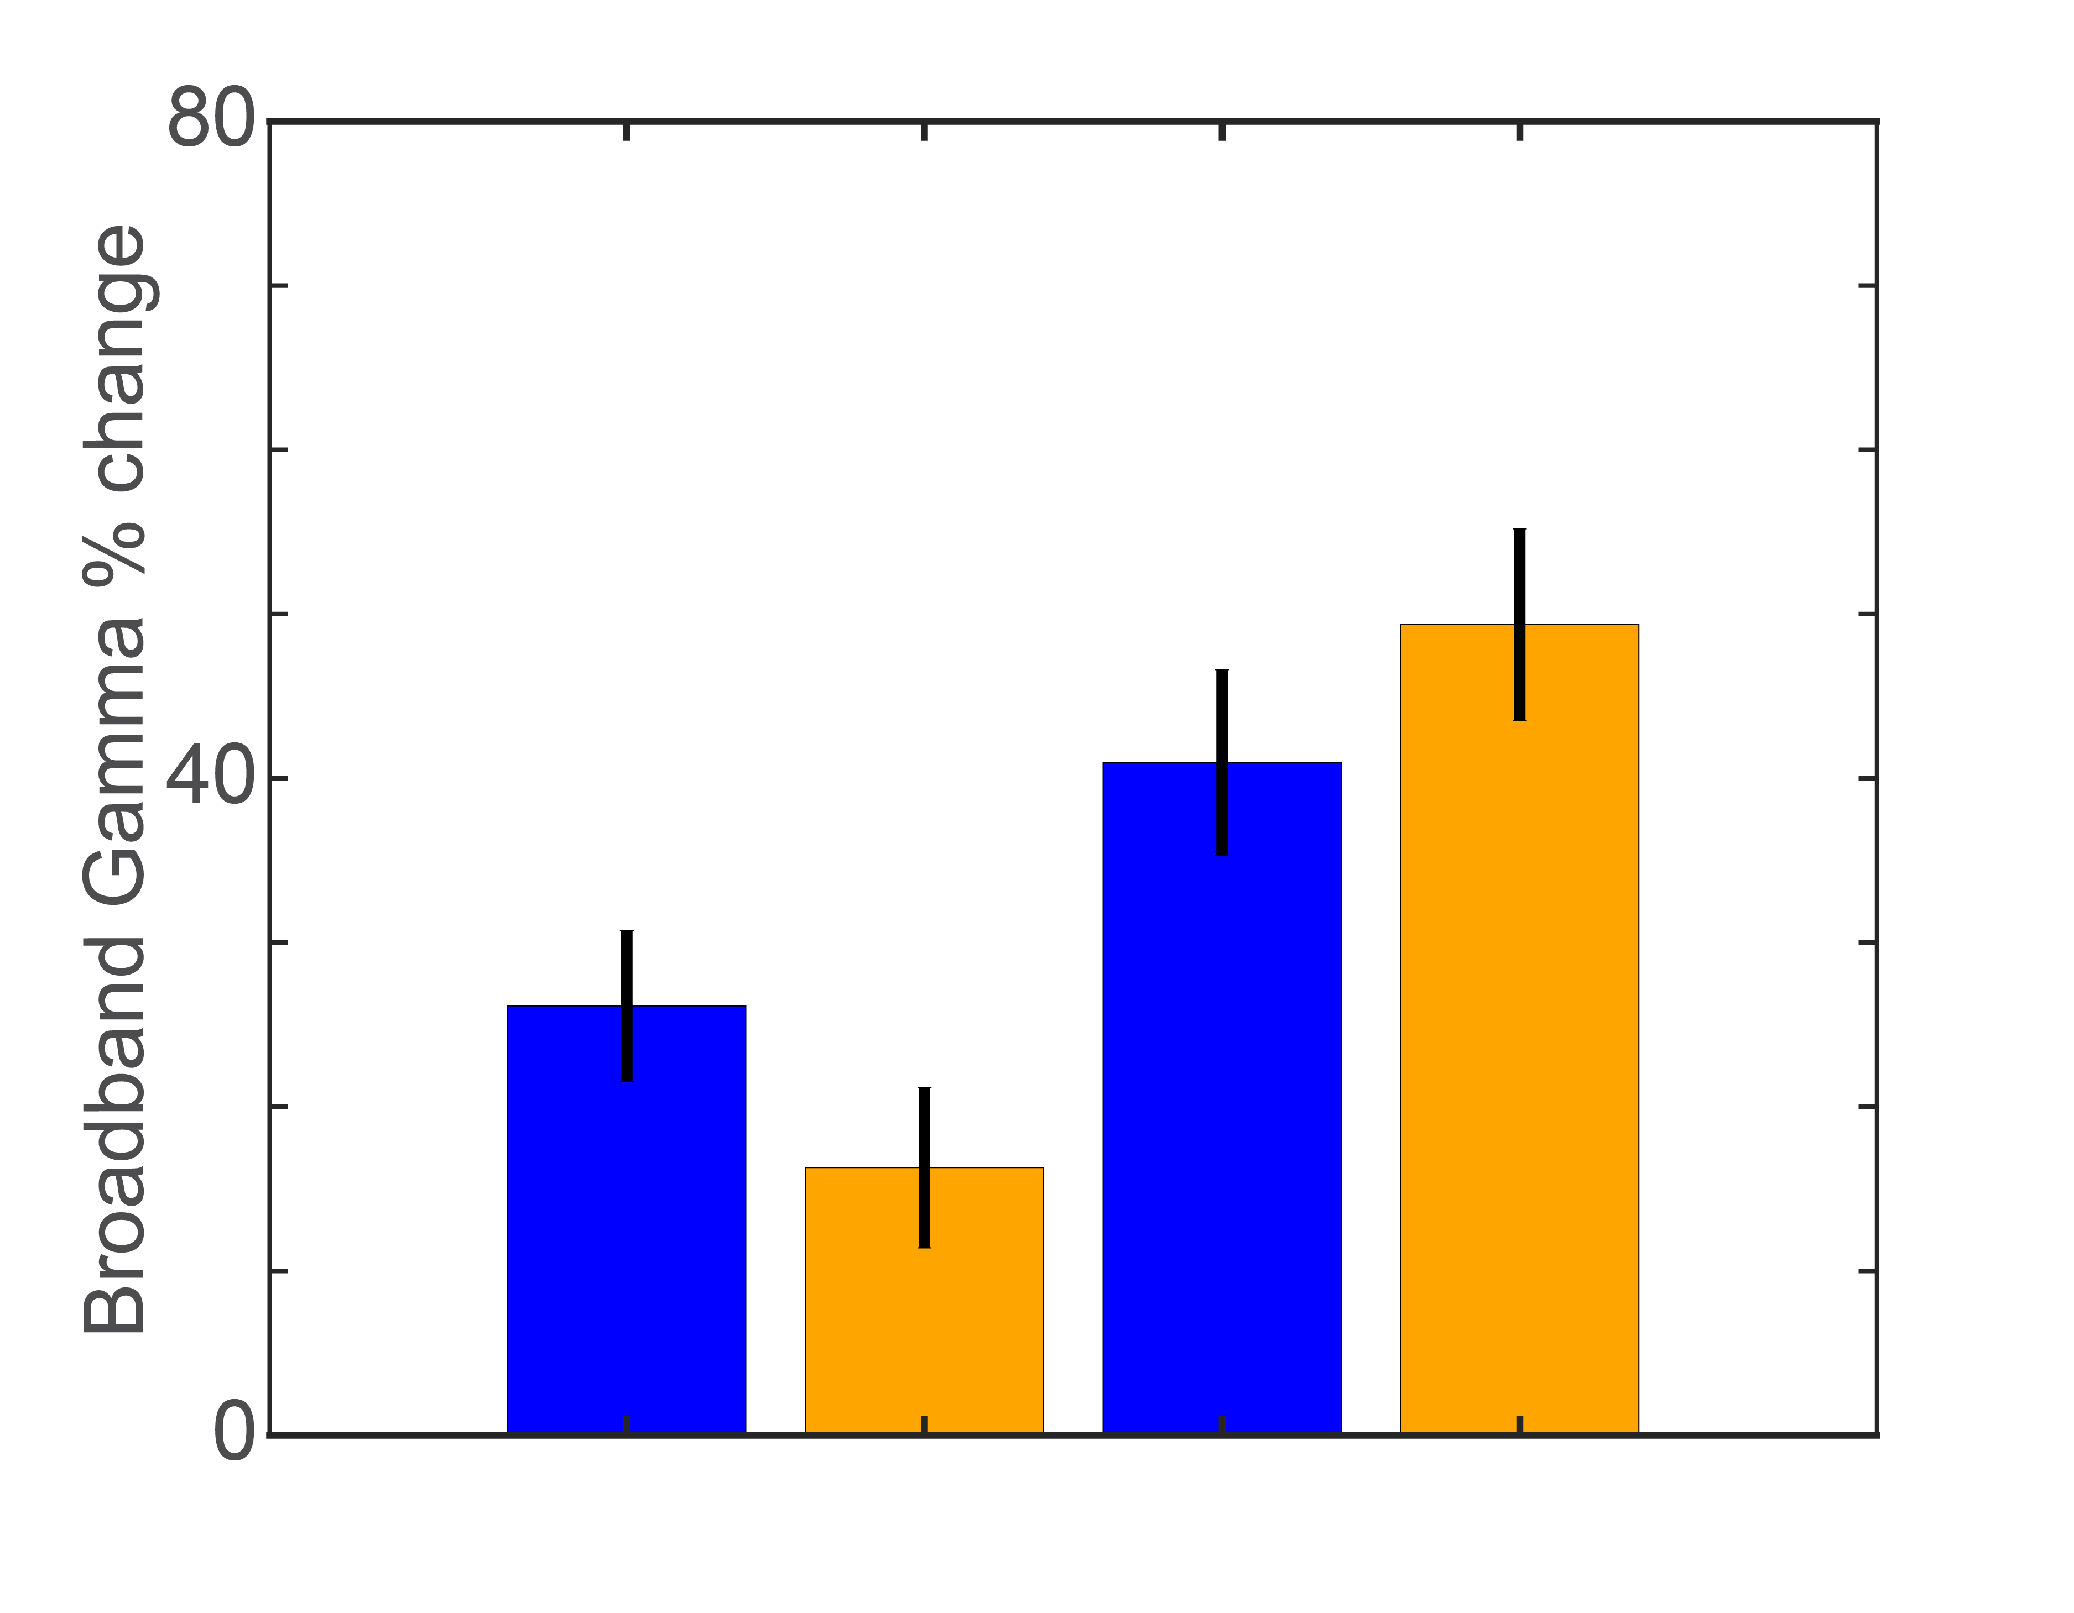
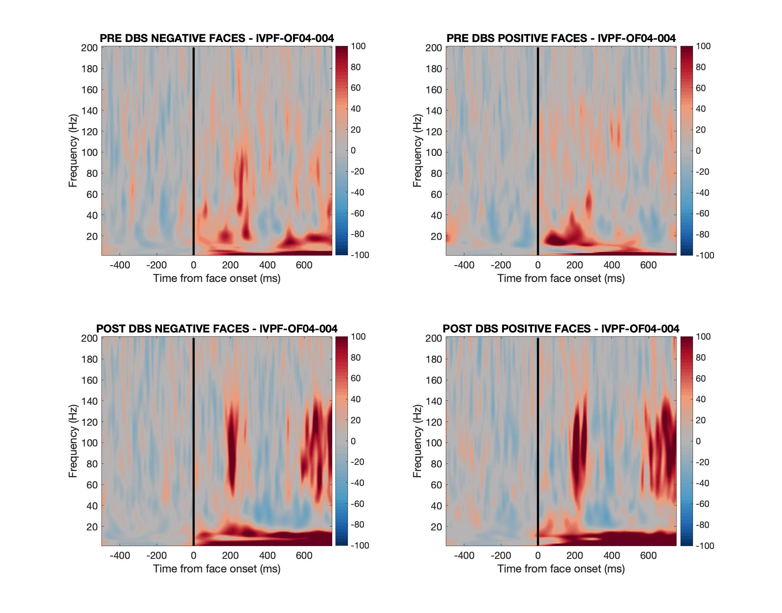
Affective Bias and Electrophysiology as Biomarkers of Treatment Resistant Depression
Salma O. Elhassa ^{1,2}, Eleonora Bartoli ², Madaline Mocchi ², Brian Metzger ², Kourtney Kanja ², Brian Cui ², Prathik Kalva ², Bailey Pascuzzi ², Anusha Allawala ³, Joshua Adkinson ², Sameer A. Sheth ², Kelly R. Bijanki ²
¹Baylor College of Medicine Post-Baccalaureate Research Education Program (BCM PREP ²Department of Neurosurgery, Baylor College of Medicine, Houston, TX
³Department of Biomedical Engineering, Brown University
Introduction
Methodology
Conclusions
Deep brain stimulation (DBS) has shown inconsistent success in alleviating symptoms of treatment-resistant depression (TRD).
Developing a biomarker that can track improvements related to DBS therapy is essential to improving patient outcomes.
TRD patients often perceive emotional stimuli more negatively than non-depressed populations. This tendency is known as an affective bias (AB) and is a potential biomarker for TRD, but it is unknown how AB is related to neural activity and mood after DBS.
Here, we examine how affective bias and neural recordings in the orbital frontal cortex (OFC) changes after DBS in TRD patients during the 10-day inpatient stay.
Affective Bias Task (ABT).
a) Patients view on a monitor faces expressing neutral, negative or positive emotions (Valence). Faces display different intensity of emotions, being morphed from neutral (0%) to sad, and neutral to happy in steps of 10, 30, 50, and 100% (Intensity).
b) Faces were presented on a black background one at a time and participants used a slider bar to rate the emotion of the face (from very sad to very happy).
Each patient viewed and rated 180 faces before DBS and repeated the experiment after several days of DBS therapy.
Expected ratings based on normative data from 400 healthy controls were subtracted from the observed ratings to compute the Affective Bias score.
Our results indicate that DBS therapy affects the response to emotional stimuli. The modulation of the emotional ratings is not identical across our sample.
DBSTRD001: we find a negative bias in response to all emotional stimuli before DBS. After DBS, the rating of sad faces is happier than expected. However, the bias for happy faces does not improve.
DBSTRD002: after DBS, the bias for happy faces is reduced. The patient showed virtually no bias in rating sad faces.
Neural changes: local activity in left OFC, quantified by broadband gamma amplitude, responds more strongly to emotional stimuli after DBS therapy (for both patients). OFC activity might reflect an increased and more accurate processing of the emotional content of the stimuli.
Hypothesis
We expect that AB will decrease in response to DBS in patients who perceive emotional stimuli more negatively, and this will be reflected in OFC neural activity.
Results
Future Directions
OFC: TRD patient#1
We plan to expand our study by further characterizing the changes in neural activity pre and post DBS:
1) Analyze other neural activity metrics, such as low-frequency oscillations and the 1/f feature, capturing the ratio between low and high frequency brain signals.
2) Covariate neural activity metrics with changes in the Affective Bias Score to identify the best accurate biomarker of mood.
3) Investigate the reliability of the Affective Bias Task in capturing depression symptoms and severity in larger populations and the ability to track online changes in response to various DBS parameters.
Experimental Approach
We leverage a clinical trial employing stereo electroencephalographic recordings (sEEG) to record neural activity with high precision in areas known to be abnormal in TRD. Neural recordings were obtained before and after several days of DBS intervention, while testing for associated changes in mood using the Affective Bias Task.
DBSTRD001
preDBS: negative faces
postDBS: negative faces
PreDBS
PostDBS
OFC: TRD patient#2
Stimulation
Significance
DBSTRD002
By characterizing the relationship between changes in emotional bias behavior and intracranial electrophysiological markers, we move the field toward a more nuanced understanding of the pathophysiological underpinnings of TRD and test individualized treatment approaches in the future.
preDBS: negative faces
postDBS: negative faces
PreDBS
PostDBS
Figure 1. Schematic of sEEG and DBS leads placement. Surgery consisted of intracranially implanting four DBS leads in the subcallosal cingulate cortex (SCC) and ventral capsule/ventral striatum (VCVS) and 10-12 sEEG electrodes (bilateral dorsolateral, ventrolateral and ventromedial prefrontal cortex, orbitofrontal cortex, anterior cingulate cortex, mesial temporal lobe). Reproduced from [7].
Stimulation
Funding
Figure 5. Neural Results: The activity in OFC is higher after DBS for all emotional stimuli (negative, positive).
Top right plots show the location of the sEEG electrode analyzed for each patient (left orbitofrontal cortex, OFC) on the sagittal and axial view. Bottom right plots show the spectrograms of the neural signals in OFC during the ABT. The plots show the spectral content of the signal expressed as % signal change from pre-stimulus At time=0ms the emotional stimulus appeared on the screen.
To capture the early response to faces, we extract broadband gamma amplitude, a metric of local neural activity, by averaging the %signal change between 50-150 Hz and between 150-300 ms.
The left plot shows the average broadband gamma %change (+/- SE) occurring in OFC in response to positive and negative emotional stimuli pre and postDBS.
Figure 3. ABT ratings: The average face emotion ratings are displayed (with standard errors, SE) for each intensity level and valence (blue: positive emotions, yellow: negative). The expected ratings (based on normative data) are displayed for reference (black: positive; gray: negative). The pre and postDBS ratings are displayed with a different saturation (lighter: preDBS, darker: postDBS.
Figure 4. Affective Bias: The average Affective Bias (+/- SE) is displayed for pre and postDBS for positive and negative emotions. The Affective Bias score for each emotional stimulus is computed as Bias = Observed rating – Expected rating. Bias scores are then averaged across stimuli with different intensity levels. Positive Bias scores capture stimuli rated as ”happier” than expected, negative bias scores as “sadder” than expected based on the normative data.
R25-GM069234-19 PREP Program Training Grant, K01-MH116364 (PI: Bijanki), R01-MH127006 (PI: Bijanki), UH3-NS103549 (PIs: Sheth, Pouratian, Goodman).
References
^{[1]} Sheth, S. A., Biol Psychiatry. 2022 Aug1;92(3):246-251. ^{[2]} Lozano, A. M., J Neurosurg. 2012 Feb;116(2):315-22. ^{[3]} Riva-Posse P., Mol Psychiatry. 2018 Apr;23(4):843-849. ^{[4]} Veerakumar, A., J Neurophysiol. 2019 Sep 1;122(3):1023-1035. ^{[5]} Bergfeld IO., JAMA Psychiatry. 2016 May 1;73(5):456-64. ^{[6]} Malone D.A. Jr., Biol Psychiatry. 2009 Feb 15;65(4):267-75. ^{[7]} Allawala, A., Neurosurgery. 2021 Jul 15;89(2):E116-E121.^{[8]} Groppe, D. M., J. Neurosci. Methods. 2017 Apr1; 281, 40-48. ^{[9]} Jenkinson, M., Beckmann., Neuroimage. 2012 Aug 15;62(2):782-90. ^{[10]} Papademetris, X., Insight J 2006, 209 (2006).
Acknowledgements
We would like to thank the research participants for giving so freely of their time and energy in support of this project.
Notes:
Background
Deep Brain Stimulation (DBS) has been employed for many years to treat a variety of brain dysfunctions. DBS use has been extended to treatment-resistant depression (TRD). Stimulation is typically targeted to the subcallosal cingulate cortex (SCC) white matter or the ventral capsule/ventral striatum (VCVS), which innervate structures known to be abnormal in depressed states. However, the complexity and heterogeneity of mood disorders creates a challenge: how to assess and track improvements related to DBS therapy? TRD patients often exhibit an Affective Bias: they perceive emotional stimuli more negatively than non-depressed populations due to dysfunction in processing emotional content. Therefore, measuring Affective Bias and the neural responses to emotional stimuli may serve as a more accurate cognitive biomarker of mood and help quantify and track DBS therapeutic effects.
Question + Hypothesis
How is AB altered in response to DBS, and does this change in behavioral AB correspond to changes in OFC neural activity? We expect that AB will be altered in response to DBS in patients who perceive emotional stimuli more negatively, and this will be reflected in OFC neural activity.

